Slide 1
Brad Vaughan Vice President – DCIO Sales Consultant November 11, 2015
Notes:
Thank the client and the firm.

Slide 2
The Traditional DC Mindset
SHIFTING YOUR DC MINDSET
Notes:
This shifting mindset has two major implications for the advisor’s business. Why advisors should care is two-fold:
If advisors have any genuine care for their clients, they want to help them retire successfully. It’s a symbiotic relationship….advisors help the plan and participants, assets go up, advisors may get paid more, etc. But 30 years ago, retirement savings was a 3-legged stool: DB/pensions, Social Security, and maybe a DC plan. Now, pensions are growing extinct, social security is on more tenuous ground, and the DC plan will serve as the primary source of retirement income for younger generations. DC plans are going to shoulder more of the retirement income burden for millennials. So advisors owe it to their clients, and to their participants, to make sure we get this DC system right and younger participants are put on the path to a successful retirement.

Slide 3
The Baby Boomer 401(k) Experience: 1981–2015
1981
2015
401(k)
Target risk funds
Catch-up contributions
Retirement income
Menu design 404(c)
Auto-enrollment
Target date funds as QDIAs
Notes:
2. Since the inception of the 401k in 1980, every service and innovation has been developed to cater to the baby boomer demographic. Advisors have built value propositions based on boomers as well. However, boomers are retiring, millennials are taking over workforce. Selfishly, if advisors want to retain a viable practice, they will have to innovate their business model to engage millennials – because they save, invest, and engage in vastly different ways than did the boomers. Helping them is going to require a change in strategy and tactics.
All of these products, services, and innovations have been developed to cater to the boomers.
Think of the time and effort devoted to “Retirement Income” – current focus of significant research and product design around distribution of accumulated wealth.
Millennials are vastly different than boomer predecessors. It will require a change in strategy and tactics to successfully engage them. If advisors are not going to innovate their practice and value proposition, there is an inherent risk in them failing to remain a viable player in the DC space.
Kodak, Blockbuster, Blackberry
So today we are going to examine three key components of the millennial generation: who they are, what their market experience has been thus far, and what motivates them to make better decisions – and strategies and tactics that you can recommend and implement with your sponsors to help millennials succeed.
Animation Note:
Time line will build. First the arrow, dates then each event. Each event will be Point, line then event name.
Timeline builds when page is shown.
Each event is activated with a click.

Slide 4
Generational Definitions
In 2015, they are…
age
20-33
age
51-69
80 million
76 million
age
34-50
59 million
Baby Boomer 1946–64
Gen X 1965–81
Millennial 1982–95
"Baby Boomers vs. Millennials: Who Would You Rather Hire?". Time Magazine.
Notes:
Just to level set and clarify what we mean when we use terminology like Boomer and millennial, here are loose age rangers of the demographics. To note, there are no hard and fast age bands – but these ranges are generally accepted to represent each of the age cohorts.
Illustrate a current age range of each generational demographic.
Why don’t we focus as much on Gen X? What sociologists have found is that Gen X represents a “transitional generation,” with its older members behaving more like the younger baby boomers and its younger members more like the older millennials. Understand also that these differences aren’t true for every individual but do speak to the overall group experience.
Given that we probably have both boomers and millennials in here, it is not my intention to offend anyone in this room – we’re addressing trends using broad, sweeping generalities.
Animation Note:
Animation will be the same as the previous version somewhat.

Slide 5
BUTTONED-UP vs. Casual
Notes:
Life Experience Contrasts of Baby Boomers & Millennials:
Key attitudinal contrasts of the actual workplace experience.
Baby boomers are traditional with regard to their life and career path: graduated school, settled down, got married, had children, and made a career for themselves.
When they graduated, their parents came to them and used phrases like “It’s time to buckle down and get your act together,” and “you’re not a kid anymore.”
Embrace face-to-face interactions where they have to be prepared, “on”, and ready for immediate feedback.
Very loyal to their companies. In a recent poll, 84% anticipate staying with their current employer until they retire.
Compare that transition to adulthood with that of a millennial:
Millennials graduate; maybe take a few years off to travel, backpack around Europe, and then figure out what they want to do. Adulthood doesn’t begin at 22 for them, it begins somewhere around 28 or even 30.
- They fully expect to change jobs – sometimes having 5 or 6 jobs by the time they’re 30. 91% of millennials anticipate staying with their current employer for less than 3 years.
And since childhood, they have been instructed to think of themselves as “special.” Their parents said things like, “Take some time and think about what you want to do with your life. Don’t rush into anything.” They are highly encouraged to express themselves.
In fact, they are so expressive, that 40% have at least one tattoo / 18% have six or more / ¼ have a piercing that is not in an earlobe. This expressive behavior is so pervasive, that the Pew Research Group put out a “How millennial are you?” poll a few years ago. And two of the questions were, “Do you have a tattoo or not?” And “Do you have a piercing in something other than an earlobe?”
Embrace “texting”, facebook, twitter, Instagram – shorthand way of communication. Reluctant to engage in direct communication or verbally with customers, colleagues, and management. And their approach to written communications and email tends to lack professionalism.

Slide 6
Super Star vs. Team Player
Notes:
I. Baby Boomer Demographic: Traditional “Independent Contributor”
Growing up, what were the only two ways a kid playing sports could get a trophy? 1) Being the MVP, or 2) winning the championship. In other words, you had to be the best. In adulthood, that manifested itself into Boomers working hard, being very ambitious. They are quite competitive in the workplace. Boomers largely credited with creating the traditional concept of the “workaholic.” They are going to sit at their desk, come up with the idea, the strategy, the plan…present it to their boss or superiors, and then if it gets implemented, only then do they expect to be rewarded with a raise or promotion.
Tend to have difficulty adjusting to workplace flexibility trends, hence, they believe in "face time" at the office and may fault or resent younger generations for working remotely.
Often view younger generations as narcissistic or lacking commitment.
II. Millennial Demographic: “Collegial” Employment Atmospheres
Similarly, the millennial demographic is absolutely interested in individual achievement and prosperity; not however, when compared to Baby Boomers.
They are generally more comfortable in a collaborative, team-setting environment where ideas and information flow freely. And they are of the “no child left behind” generation. When kids these days play sports, who gets a trophy? EVERYBODY. That manifests itself in millennials viewing the workplace as a more collaborative environment; but they also sometimes feel as though they’re entitled to rewards and advancement simply for doing their job. They think, “Hey, I show up to work every day. I should be promoted!”
But before we paint this gloomy image in your head of wild, entitled, tattoed teenagers demanding promotions, we need to recognize the positive traits that influence how we interact with millennials:
They are very well-educated and well-informed. In fact, they are on pace to be the most well-educated generation in history. One in four is working on an advanced degree; and access to information is not kept in a library (or an enrollment kit)…it’s at their fingertips.
They are extremely well-traveled. More than 250,000 study abroad every year.
Millennials have high expectations of their employers, seek out new challenges and are not afraid to question authority. They also are more discriminating when it comes to working for an employer who is giving back, environmentally conscious, and offers perks in the form of volunteering opportunities.

Slide 7
Technology: Tool vs. Lifestyle
Notes:
Regarding technology, there are not stark contrasts between the generations. But there are nuances to how they use technology and how it affects their daily lives.
Baby Boomer Demographic:
Technology is embraced as a tool to complete tasks more efficiently. “I’m going to log in, fire off a few emails, check into my flight, download my boarding pass, and then I’m off to do something else around the office/house.”
II. Millennial Demographic:
By comparison, for millennials, technology has moved beyond being a functional tool to get information and execute tasks—it now serves as a the primary mechanism for both professional interaction and personal interaction and entertainment. Millennials go online and literally hang out.
Bottom line: Boomers would survive if you took away technology. Gen Y would have to learn how best to communicate verbally.
“Digital Immigrants verses “Digital Natives”
Given the evolving demographic landscape and different attitudes of current & prospective participants, what are the potential considerations and opportunities for plan sponsors and advisors to enhance plan design and services?
Animation Note:
Animation – Boomer will slide in from left then Gen Y slides in from right … Animation will be the millenials texting back and forth a couple times.

Slide 8
Potential Opportunities
Build credibility with sponsors and drive better outcomes
Recommend plan design and service enhancements that cater to frequent job changers
Develop an effective rollover strategy to capture existing assets from previous employer plans
Leverage social media tools; explore ways to build an online community of employees within a plan
Engage with points of influence to develop a peer network; find ways to incorporate peer benchmarking
Notes:
Advisor Alignment / Value Proposition:
Plan advisors who recognize the unique preferences of millennials can differentiate themselves by building credibility with sponsors – which should translate to increasing assets in the plan; and presumably over time reduced plan expenses in accordance to industry pricing structures.
I. Build Credibility: Frequent job changes of the millennial demographic suggests a need for plan sponsors to implement immediate eligibility and auto-enrollment to promote and encourage younger participants to save immediately, and automatically.
But up until now, auto-services were deployed on a generation that was very company loyal. What happens when you overlay auto-services—which the industry hails as a best practice—on millennials? Follow this example:
23 year old gets a job and is auto-enrolled at 3%. Their employer offers auto-increase. So they start at 3%, the next year it goes to 4%, the next year it’s 5%, and then they switch jobs.
They get auto-enrolled at their new job at 3%. The new employer offers auto-increase….so the next year they move to 4%, and then 5%, and then they switch jobs.
There are two unintended consequences occurring here:
1. Even though their employers offer auto-services, this participant is never going to get to 15% savings – which is the level that most financial professionals will say participants need to save in order to maintain their standard of living in retirement
2. This participant is starting to accumulate a LOT of old DC balances in their wake of changing jobs. This screams for the need for providers to start offering much better, more comprehensive, rollover aggregation services. Several providers are already doing this…and they claim that when a sponsor takes them up on their rollover aggregation service offering, plan assets increase an average of 7-10%. That’s a win for participants, the sponsor, the advisor, and the recordkeeper. Why not get in front of this trend and start to develop a scalable rollover-in service offering? Or partner with providers to help younger participants aggregate balances.
II. Drive outcomes:
Power of peer recommendation is getting a massive amount of attention as a way to influence consumers. Not just in the DC industry but across all industries.
McKinsey quote: “Marketers may spend millions of dollars on elaborately conceived advertising campaigns, yet often what really makes up a consumer’s mind is not only simple but also free: a word-of-mouth recommendation from a trusted source.
Peer testimonials at enrollment meetings
Peer benchmarking – sponsors are like teenagers
Putnam example.

Slide 9
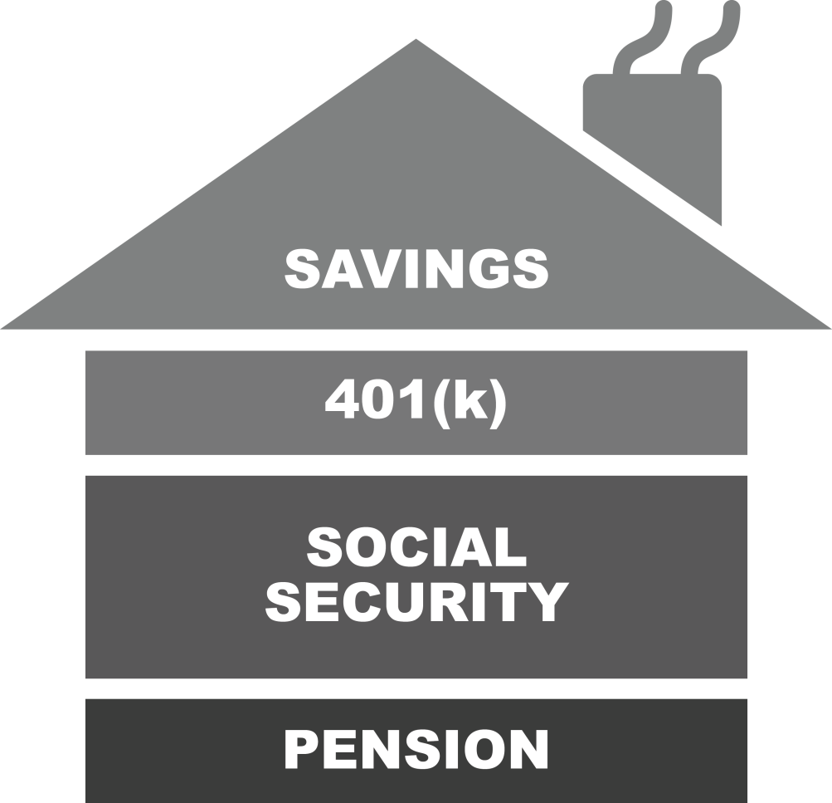
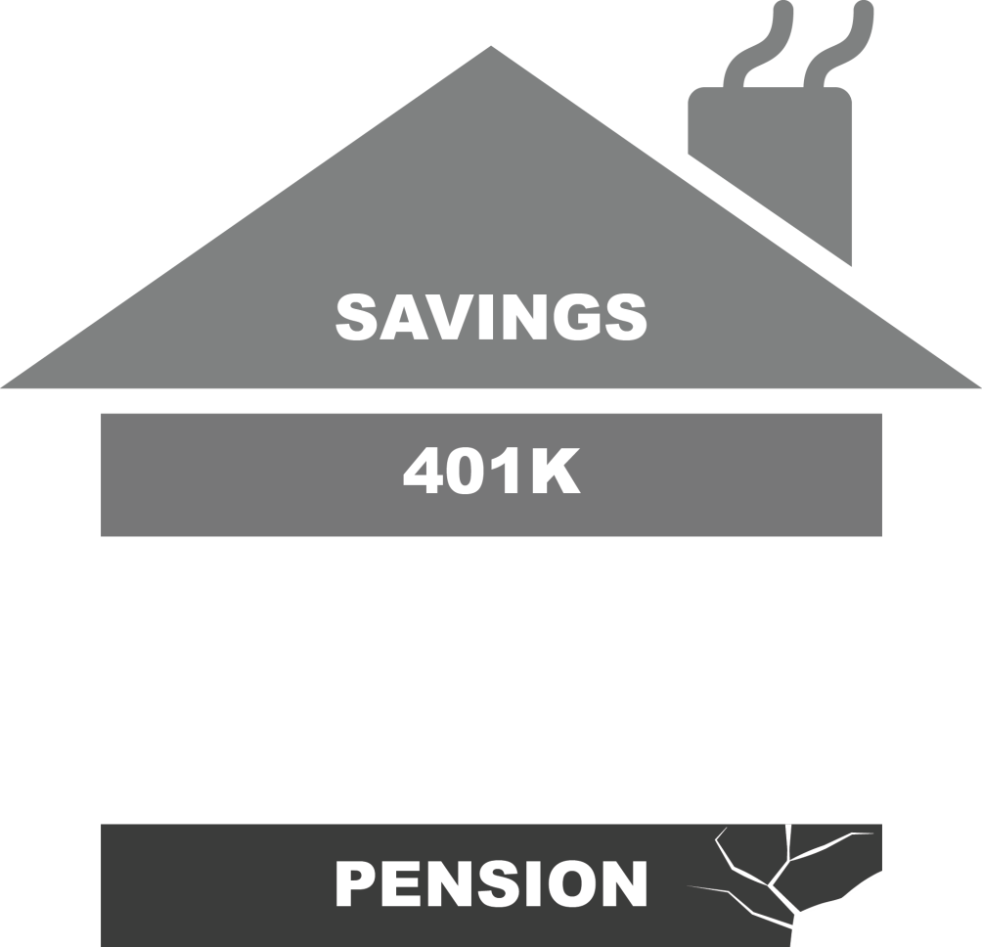
The Retirement Foundation Is Deteriorating
Notes:
Those are just a few attitudinal contrasts. Now let’s shift our attention to financial differences, starting with contrasts in the deterioration of the retirement foundation over the past 10-20 years.
Baby Boomer Metaphor: Consider the house metaphor. While the retirement income picture for all Baby Boomers isn’t certain, this generation can count on Social Security payments continuing in some fashion, and a number still have some form of a traditional pension. And of course, they have the money they’ve saved in employer-sponsored retirement plans—and their own personal savings.
Millennial Metaphor: Towers Watson analyzed the Fortune 500 companies who have offered a DB plan from 1998 through 2013. In 1998, 299 of them had some form of DB plan (about 60%). In 2013, that number had dwindled to 118 (about 24%). The future of Social Security is far from secure, and for future generations in the private sector, a pension will be virtually unheard of. As we mentioned at the beginning of the presentation, going forward, the DC plan is going to be counted on to shoulder the majority of the retirement income burden for future generations.

Slide 10
And There are Major Impediments to Saving
SALARY
UNEMPLOYMENT
DEBT
Notes:
Compared to what Baby Boomers faced at similar ages—real salaries are lower, levels of debt are higher (a result of college costs increasing must faster than the rate of inflation for decades, more kids going to college, and the proliferation of credit card debt), and unemployment is higher—particularly for younger individuals.
Real salaries are down compared to previous generations. But the other two factors on here are the biggies. Generation Opportunity, which is a non-partisan, non-profit, millennial advocacy organization. They calculated the unemployment rate for 18-29 year olds at 15%. And debt is the other detriment.
Every major league or NFL game I attend has credit card company booths giving away free beach towels, t-shirts
Every freshman orientation day on college campuses has credit card booths there
Documentary: Maxed Out
Animation Note:
Animate so salary is pushed down a lot, unemployment is pushed up a bit, and debt is pushed up a lot

Slide 11
Slow and Steady to Boom and Bust
Real Estate Bubble
Dot-Com Bubble
1,800
1,000
S&P 500
0
1981
1995
1996
2014
Notes:
Perhaps nothing more definitively represents the differences between the Baby Boomer and millennial financial experience than this chart of the S&P 500 for the past 35 years.
Remember—the 401(k) was introduced in 1980, when the first Baby Boomers were turning 34. The years subsequent, came an era of gradual, steady and consistent growth, marked by “regular” recessions.
Examine what has happened since 1995—the year the last millennial was born.
One of the best ways I’ve heard to describe how economic events influence investment behavior is the “fingerprint on the brain” analogy. For children growing up, from about ages 3-10, every experience they go through leaves a fingerprint on their brain: interactions with families, friends, teachers; vacations they take, activities they participate in – all of that helps shape who they become and how they view and interact with the world around them as they move into adolescence and then adulthood. The same is true for an investor’s first 7-10 years. And everything a millennial has experienced….a Dotcom bubble, Corporate corruption [Enron & WorldCom], Ponzi Schemes [Bernie Madoff], Two Recessions, Lehman Brothers, government bailouts [automobile and mortgage firms], “The Lost Decade.” All of those events have left investment fingerprints on the brains of young participants. Now, ALL investors, young and old, have experienced the ups and downs of recent market events. But young investors don’t know any better – it’s the ONLY thing they’ve experienced. How do you think that manifests itself in their investment behavior?

Slide 12
What We’ve Seen at T. Rowe Price
Percent of Non-TDF Users Age 20–34 With Greater Than 80% of Their Account Balance Invested in Cash
30%
25%
29%
26%
26%
20%
15%
10%
5%
0%
2012
2013
2014
Source: T. Rowe Price Retirement Plan Services 401(k) accounts that are currently active, have a positive balance, and do not include any assets invested in target date funds. Cash includes money market and stable value funds.
Notes:
Is it any wonder that younger individuals who participate in employer-sponsored plans on a purely self-directed basis—in other words, without the benefit of target date funds—are under exposed to equities and even bonds…and are over exposed to cash?
These are astounding figures for such a young demographic – and they are inextricably linked to the fact that because of the past decade, younger investors have that “fingerprint on the brain” that has led to extreme risk aversion. The volatility of a few years ago has fostered an age-Inappropriate asset allocation strategy for a population that can actually afford to take the most risk.

Slide 13
Potential Opportunities
Build credibility with sponsors and drive better outcomes
Promote an age-appropriate default investment for auto-enrollment
Elevate the initial default savings rate
Couple that with steeper auto-escalation increases
Provide younger participants with the opportunity to delegate (or validate) retirement investment decisions
Notes:
Again, you can use your knowledge of the millennial investing experience to your advantage in conversations with sponsors.
From what we’ve seen, a good portion of young participants investing on their own are vastly under-exposed to equities. Solve that challenge by defaulting them into an age-appropriate investment.
If you look at the most recent PSCA Surveys or a number of others, sponsors often say that the reason they don’t default participants higher than 3% is a philosophical one—infringing on their employees’ freedom to choose, and it will lead to higher opt-out rates. However, we took a look at all of our sponsors who as of December 2014 utilize auto-enrollment at a 3% default vs. a 6% default, and the opt-out rates were exactly the same: 3.8%. This refutes the theory that more employees will opt out at higher defaults.
Take emotion and hesitation out of the equation for millennials by allowing younger participants to delegate (or validate) retirement investment decisions. Incorporate target-date funds, investment guidance, advice services, managed accounts into the plan and let them leave important retirement savings decisions to a disciplined professional. The delegation can occur with the implementation of auto-services.
The validation speaks to the example I provided earlier about peer recommendation. Retirement investment information can be accessed anywhere – so younger investors who seek information out online may start to formulate their own opinions about how they think they should save and invest. By providing guidance services, or allowing them to hear testimonials, it can help validate the thoughts they may have developed about their plan. Amazon example.

Slide 14
T. Rowe Price Milestone Study
2,000
200
participants
plan sponsors
Notes:
So we’ve talked about who they are, we’ve seen what their investment experience has been. Now let’s take a look at what makes them tick – what drives their savings decisions and motivates them.
T. Rowe Price conducted a study a few years ago – surveying over 2,000 participants as well as 200 plan sponsors. The key objective was to better understand participant needs, attitudes and behavioral drivers. We asked them questions like, “What would cause you to save more? What would cause you to save less? Would changes in plan design make a difference?”
In the following section of the presentation, we’ve chosen the 20-29 age segment to represent millennials, and the 50-59 segment to represent the Baby Boomers.
Animation Note:
Animation – Right now this is just an image but we would have a build during the speakers dialogue but may be distraction. Maybe just having the signs fade in would be ok.

Slide 15
#1 Financial Goal by Age Group
Saving for
retirement
44%
35%
Paying off debt
Paying off debt
19%
35%
Just getting by
Just getting by
18%
10%
Saving for
retirement
Notes:
Regardless of age, there are relatively few financial goals—but the different age groups have very different priorities.
This illustrates what they are actually able to do…top priorities.
70% of millennials are either paying off debt, or JUST GETTING BY.
70% of millennials think that financial stability means paying their bills on time. - American Institute of CPAs

Slide 16
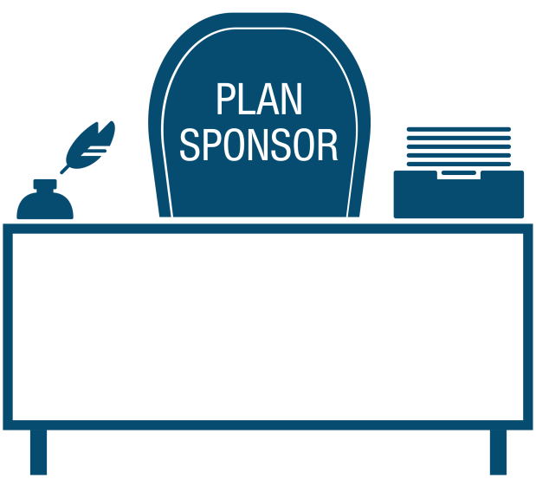
Thinking About Retirement Goals
I’m starting to think about my retirement goals in my 20s/30s
Employees start setting their goals in their 30s/40s
Source: 2010 T. Rowe Price Milestone Study.
Notes:
Interestingly, while saving for retirement isn’t the priority for most in their 20s, many are definitely thinking about retirement and their retirement goals—or begin doing so by their 30s.
Our research shows this comes as a surprise to plan sponsors, who responded that participants don’t start thinking about these goals until they’re in their 30s or 40s.
So, not only do we see a disconnect between what sponsors and young participants think; we see that young participants are thinking about retirement—but many don’t have the financial means to act upon it.
The result is…
Animation Note:
Animation –Desk/chair slides with pen/quill and stack of paper falling on desk then then thought bubble grows and copy appears then Woman slides up from bottom and then line builds and thought bubble grows and copy appears

Slide 17
Awareness Without Ability Creates Fear, Denial, AND Anxiety
I’m worried
Creditors are calling
How do I save for retirement?
Need to pay the bills
School loans
Notes:
In this scenario, one has to ask—what good is awareness when the average 20-something is overwhelmed with debt and living paycheck to paycheck?
From the previous slide, we saw that:
Paying-off debt – 35%
Making ends meet – 35%
They know it’s important, they think about it early on in their careers, and they often times have access to very good information, but they don’t have the ABILITY to do anything about it.
Might they just feel overwhelmed—or be forced to ignore the importance of starting to save for retirement as early as possible?
The one advantage they have is time.

Slide 18
Top 3 Milestones to Save More for Retirement
Ages 50–59
Ages 20–29
Current events/economy
27%
Becoming a parent
29%
Health
21%
Current events/economy 19%
Reaching a certain age
20%
Marriage
17%
Source: 2010 T. Rowe Price Milestone Study.
Notes:
Now we’re going to see how various triggers, events and milestones will influence or have already influenced (triggered) them to save more, or less, for retirement.
Millennials:
Becoming a parent, current events/the economy and marriage are the triggers most likely to cause them to increase or have already caused them to increase their retirement savings.
It sounds counter-intuitive that getting married or having a child would cause one to save more for retirement; because usually those two events extract money from you. But I liken those life events to a “responsibility alarm.” “It’s not just me waking up on my buddy’s couch every weekend…I have a family to think about.”
But there is an important takeaway from this slide that spans the generations. Look at the left hand side and the Boomer responses. We all know people react to market events and the economy. But look at the other two boomer responses: reaching a certain age and health. Again, two very, very emotional life events that someone is going through.
When you combine those with getting married and becoming a parent – we’re talking about huge, personal, emotional events that would cause people to make a better decision. Recognizing that fact and being able to frame that with sponsors and participants could give you a unique way to position yourself and some recommendations in client and prospect meetings.
You notice what isn’t listed on here? Adding a new fund; adding Roth contributions; restructuring the match. Providers spend millions upon millions of dollars crafting elaborate communications campaigns around plan design changes, and guess what?....(flip to next slide)

Slide 19
Plan Changes Don't Positively Impact Savings Behavior
1.2%
0%
^{Typical Plan Changes}
^{Company match formula change}
^{Investment changes}
^{New loan provisions}
^{Paperless statements}
^{Enhanced website}
Source: 2010 T. Rowe Price Milestone Study.
Notes:
…It doesn’t make a bit of difference whatsoever with participants of any age!
When prompted to think about the impact of plan or employer contribution changes, no one in the 20-29 group and virtually no one in the 50-59 group said these changes would cause them to increase their retirement savings.
Now, this doesn’t mean that matching rates and plan design enhancements don’t matter…they do, as other research has shown. But we as an industry are very good at telling participants what to care about and when to care about it.
And our research has shown that participants tend to be more influenced by – and take action in response to – what’s going on in their own lives.
There’s a phrase I use all the time when talking to advisors and sponsors about motivating tactics: Logic makes you think, and emotion makes you act. Dollar cost averaging and tax-deferred investing make people think, but we’ve got to tap into emotion to make most of them take action.
Animation Note:
Animation – Boomers slide in then number box slides in from left, Millenials slide in then numbers slide in from right, Gray box fades in and Typical Plan Changes fades in, then the below fades in then out, unless you’d want to have the full list appear.
Investment changes
Enhanced website
Company match formula change
Paperless statements
New loan provisions

Slide 20
Communication Preferences
Ages 50–59
Ages 20–29
49%
46%
41%
34%
33%
30%
28%
22%
19%
18%
1:1 Consultation
Online Tools With Personalized Recommendations
Educational Webinars
Electronic Communications
Print Communications
Source: 2010 T. Rowe Price Milestone Study.
Notes:
What are some other observations?
Interestingly, we didn’t see a significant difference between these two age groups in terms of communications preferences.
Everyone utilizes technology. But the key takeaway here is two-fold:
Messages MUST be available in a variety of formats. More than paper, phone, digital. It’s PC, tablet, smartphone. Think about your own technology usage and use that as a framework to how we should message to other workers.
Let’s take a poll. If any of these apply to you raise your hand and keep it raised throughout the exercise. Who here has watched TV today? Read a newspaper? Looked at a laptop or tablet? Smartphone? (And it’s only (look at watch or phone and state the time, especially in a morning meeting)….)
Messages must be there, and they must be consistent to make an impact.
What someone sees via tv, smartphone, website, or hears via phone interaction, webinar, or one-on-one meeting has to be consistent in look/feel and messaging for it to start to resonate.
We already know we’re fighting an uphill battle when it comes to communication and education of participants.
So let’s look at some of the potential opportunities of this research.

Slide 21
Potential Opportunities
Build credibility with sponsors and drive better outcomes
Promote communications and tools around holistic financial topics
Recognize the need to connect with participants on an emotional and personal level
Bundle retirement savings messages with key “milestone” events to maximize participant adoption
Tap into the innate desire to compete, to achieve results: GAMIFY to engage.
Notes:
A key finding from the Milestone study was that we have to stop thinking like providers and put ourselves in the mind of a younger participant.
Build Credibility:
Robust tools and holistic financial education is a must. You have access to a ton of holistic financial expertise. Either you possess it, someone in your firm or on your team, can provide it, or you can explore ways to partner with firms that can provide it in tandem with the other services you provide. Especially younger participants, who may be grappling with college and credit card debt; who need help creating a budget; who may need to start thinking about college savings plans for young children.
REMEMBER FINANCIAL WELLNESS.
So use that as an opportunity to build a broader financial relationship with them.
The second point, to me, is more powerful and influential than anything else we as an industry can do to help younger participants.
Now, it’s difficult as a provider to connect savings messages to those decisions. Because you only know so much about what’s going on in their lives. But a couple of things can get the wheels in motion. We know how old they are. So when someone turns 30, 40, 50, 60 – deliver a positive savings message into those dates. And the other crucial piece of information we know or can obtain….their beneficiary information. Now, people can change beneficiaries when something both good and bad occurs. But typically, it can be when someone gets married, and someone has children. And even though you don’t know the exact reason…it could be an opportunity for an open-ended conversation. “I understand you recently changed beneficiaries on your account, is there anything that we can help you with?” Chances are, if the beneficiary change was for a good reason—marriage or children—that participant is going to be more than happy to tell you about it. That’s an opportunity for a positive savings message.
Build Assets:
Identify which milestones trigger can increase OR decrease in savings.
Just as we saw that millennials tend to ramp up their savings when they have a baby; if you can get in front of a “negative trigger”—say, an economic downturn—with education to keep participants saving, you can avoid plan leakage.
Who here has heard the term gamification? Who hear has ever heard of “employee of the month?” That’s an early manifestation of how to gamify employee productivity. Who here has a Fitbit or tracks any type of fitness results through an app? That’s the gamification of physical fitness.
And if that’s how you want to incorporate gamification into your practice, that’s the simple way to do it. But it’s what all of your competitors are doing, too: leveraging providers’ online tools and calculators that provide a number or score for participants to beat.
Baseball analogy: Who here is a baseball fan? The game of baseball can be very simply explained by seeing what the final score of each game is. Oh, the Orioles won the game 7-6. But those who truly know the game of baseball – much like the advisor who truly knows the DC industry – know that there is much more nuance to the outcome than just a score. “The game within the game,” it is called.
What are some examples of the game within the game?
Bringing in a left-handed pitcher to face a left-handed batter
A defensive shift to guard against a pull hitter
A runner on first base trying to distract the pitcher late in the game
Hit and run
Pick off moves to keep runners close to the bag
[fill in names of local baseball players]
When I watch the Orioles, I see that they may have won the game 7-6. But I also know that Matt Weiters is fully healthy from Tommy John surgery because he threw two runners out trying to steal second. Had one of them gotten into scoring position – we may have ended up losing.
What about the game within the game of retirement savings? There is so much more that you can do to engage and motivate participants than just giving them an online number or score to beat.
Contests that pit teams, departments, or geographic locations against one another to see which group can increase participation, deferral rates, or knowledge of retirement best practices
Benchmarking participant behavior
Communicating year-over-year deferral rates or balances. Seeing trend information can motivate participants to beat last year’s figures.
Plan advocates or savings “champions” that can serve as the captain of the team and help motivate them to make better decisions (e.g. “play better”).
Plan design via stretch matches or “tiered” match structure (e.g. 50% on the first 3%, but 100% on the NEXT 3%)
The point is to subtely make participants and sponsors WANT to improve their plans, their retirement readiness, without knowing it. And any one of these tactics is not going to get someone’s retirement readiness score to go from a 20 to a 90; but it’s the little things you can bring and suggest, the “games within the game,” so to speak….that can end up making the difference in the long run.

Slide 22
Want to learn more?
Access our new advisor site:
troweprice.com/millennials
Access our complete repository of DC resources at: troweprice.com/dc
Notes:
CLOSING:
We recognize that differentiating yourself; innovating your business – means taking a step into the relative unknown. But if you constantly follow the business models of everyone else, that doesn’t differentiate you. In fact, as we talked about at the beginning, there is enormous risk in not innovating your business and turning your attention to the future.
And since the DC plan is going to be the primary retirement savings vehicle for future generations, it’s more important than ever for us to work to improve the entire system: successfully engaging participants, providing better and more robust savings features, and ensuring that we’re age-appropriately allocating them along the path to retirement.
Ultimately, if the participant succeeds – everyone in the industry succeeds. Plan assets go up, sponsors gain scale, and advisors, TPAs and other providers gain credibility, and strengthen their business when they can demonstrate that they are well-prepared for the next 30 years of business, rather than the past 30 years.
Questions?

Slide 23
Improving Your DC Plan: Next Generation Thinking
To learn more about our investment services, contact your T. Rowe Price representative.
T. Rowe Price Investment Services, Inc.
CZOBHSCE_NextGenPPT
2015-US-8262
Notes:
Taking the time to break out of our traditional mindset – that of the US Baby Boomer – provides us with incredible food for thought on both a strategic and tactical level as we each look for ways to strengthen retirement security now and into the future.

